Slide 1
Future of Legal Services
Prof. William D. Henderson
Indiana University Maurer School of Law
Editor, Legal Evolution
Presented to
Arizona Task Force
on Legal Services
Jan 7, 2019
Phoenix, Arizona

Slide 2
Ethics rules shape and constraint legal market
Rule 5.4 – who can own and invest
Rule 5.5 – who can do the work
Rules 7.2-7.3 – constraint marketing efforts

Slide 3

Chicago Lawyers I
Chicago Lawyers II

Slide 4
Estimate of Current U.S. Legal Services Market
Based 2012 Economic Census data adjusted upward based on growth in U.S. GDP

Slide 5
PeopleLaw

Slide 6
% of Law Office Revenue by Type of Client
2007
2012
Source: US Census Bureau Economic Survey (2007, 2012)
© Legal Evolution PBC

Slide 7
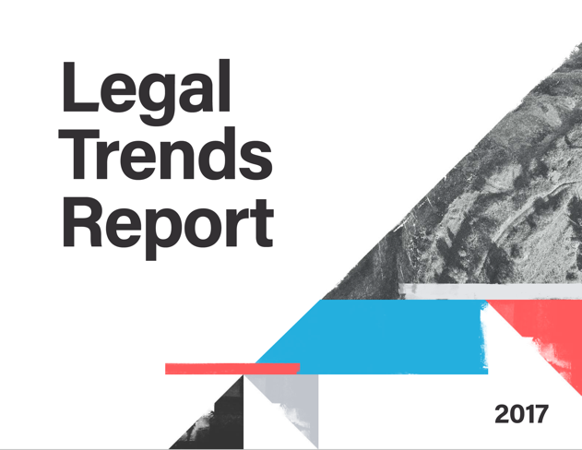
SMALL FIRM LAWYERS SERVING PEOPLE
ARE STRUGGLING TO EARN A LIVING .
2017 Clio Legal Trends Report
Hourly Rate
Hours
Billed
Collected
Income
$260/Hour
2.3 Hours
1.9 Hours
1.6 Hours
$422/Day
What went into the 2017 Legal Trends Report?
29% of 8 Hours
82% of Hours Worked
86% of Hours Billed
1,026,038 |  | matters
10,981,286.13 |  | hours billed
$2,562,864,876.43 |  | in billables
8 | award-winning data scientists

Slide 8
STATE COURTS ARE IN MELTDOWN –
GLUTTED WITH SELF-REPRESENTED LITIGANTS.
NCSC The Landscape of Civil Litigation in State Courts
“The picture of civil litigation that emerges from the Landscape dataset confirms the longstanding criticism that the civil justice system takes too long and costs too much.”
$2,441
$5,424
75%
median judgment
average judgment
of cases had at least one self-reported party

Slide 9
The “DIY” (Do-It-Yourself) Legal Economy

Slide 10
Organizational Clients

Slide 11
Complexity
Legal Complexity
Experience and Perception
1988
2018
2048
Economic Growth
© Legal Evolution PBC
11 Legal Evolution PBC

Slide 12
Complexity
Legal Complexity
Reality
Search for substitutes to deal with cost and quality
Higher profits
Rise of the Large Firms
Experience and Perception
1988
2018
2048
Economic Growth
© Legal Evolution PBC
12 Legal Evolution PBC

Slide 13
13 Legal Evolution PBC

Slide 14
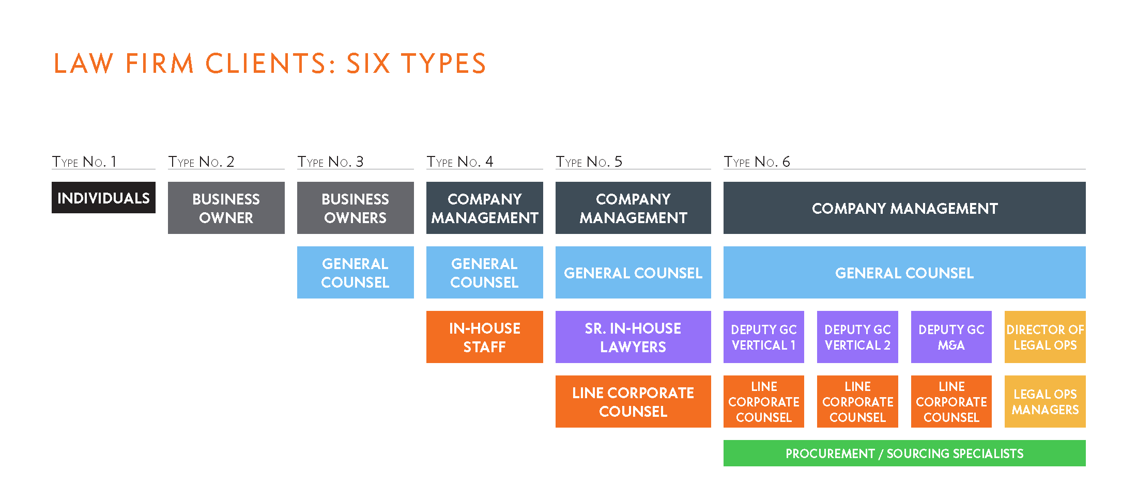
© Legal Evolution PBC
14 Legal Evolution PBC

Slide 15
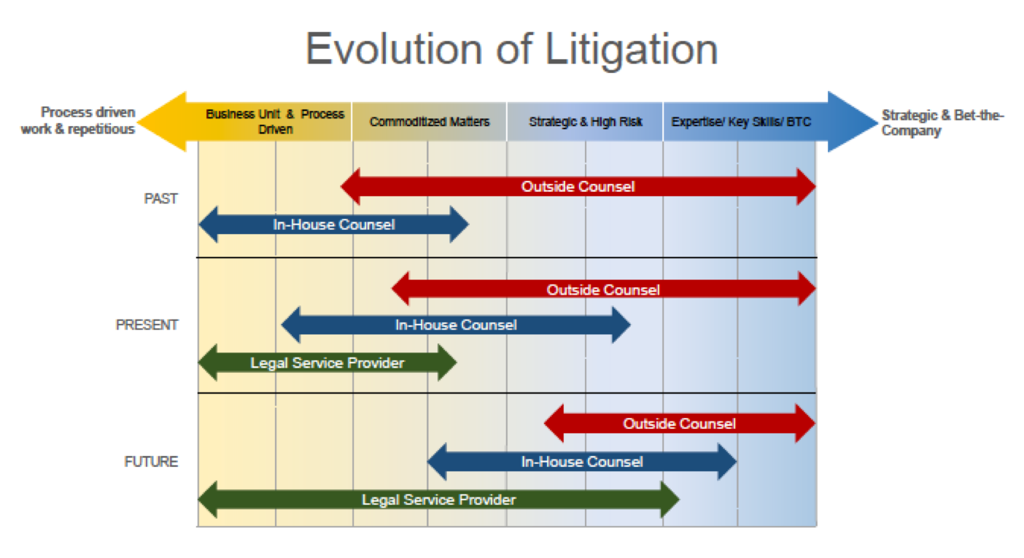
Source: Alan Bryan, Senior Associate General Counsel - Legal Operations and Outside Counsel Management, Wal-Mart Stores, Inc.
15 Legal Evolution PBC

Slide 16
Lagging Legal Productivity

Slide 17
“Human ingenuity has devised ways to reduce the labor necessary to produce an automobile, but no one has succeeded in decreasing the human effort expended at a live performance of a 45-minute Schubert quartet to much below a total of 3 man-hours.”
-- William J. Baumol & William G. Bowen, Performing Arts: The Economic Dilemma (1966)

Slide 18
Source: Data from U.S. Bureau of Labor Statistics, calculations by Legal Evolution PBC
18 Legal Evolution PBC
Notes:
Legal Services and the Consumer Price Index (CPI) (042)
January 30, 2018
https://www.legalevolution.org/2018/01/legal-services-consumer-price-index-cpi-cost-going-up-wallet-share-going-down-042/
Prices in Eds, Meds, and Legal Sector are going up faster than overall CPI-U. These sectors are among the most prone to cost disease (aka Baumol’s disease).

Slide 19
Source: Data from U.S. Bureau of Labor Statistics, calculations by Legal Evolution PBC
19 Legal Evolution PBC
Notes:
Legal Services and the Consumer Price Index (CPI) (042)
January 30, 2018
https://www.legalevolution.org/2018/01/legal-services-consumer-price-index-cpi-cost-going-up-wallet-share-going-down-042/
This chart shows how the CPI-U for legal services is going up faster than the overall index yet its share of the total basket is going down (the orange line).

Slide 20
Complexity
Legal Complexity
Reality
Division of labor, specialization
Data, process, technology
Experience and Perception
1988
2018
2048
Economic Growth
© Legal Evolution PBC
20 Legal Evolution PBC

Slide 21
Thomson Reuters Market Map
21 Legal Evolution PBC

Slide 22
Failed Storefront Revolution

Slide 25
Key Points

Slide 26
Key Point #1:
Breakdown in PeopleLaw sector
Clients
Lawyers
Courts
Cost ↑ faster than CPI
Consumers forgoing legal services
Growing DIY sector not connected to bar
Typical lawyer billing only 2.3 hours per day
Lacks skills / resources to build high-volume practice
Market is shrinking ($7B between 2007 and 2012)
75% of cases involve at least one pro se litigant
Growing mismatch between cost of litigation and amount in controversy.
Median judgment in state court = $2,500

Slide 27
Key Point #2:
Ethics rules create structure of market
Rules only protect the minority of public who can afford legal services
Significantly reduces innovation.
Rule 5.4
Limits on ownership and co-venturing
Rule 5.5
Who can practice law with ambiguity on definition
Rules 7.2-7.3
Limits on marketing that better match lawyers with clients

Slide 28
Key Point #3:
Lagging productivity + growing complexity
Solution requires collaboration with other disciplines.
Explosion in LegalTech is window on our future
PeopleLaw
Organizational Clients
Higher quality products & services at lower price points
Expansion into latent markets
Greater public esteem for legal institutions
Bar has limited influence; must collaborate with court system
Legal compliance requires increased investment in data, process, technology
Market already finding workarounds to Rule 5.4

Slide 29
Q&A

Slide 30
Thank you!

